Slide 1
Annual Conference 2021
Spatial planning for a better quality of life:
How can the quality of life in urban and rural areas be strengthened?
Spatial Planning and Quality of Life
Luxemblourg, 10 November 2021

Slide 2





// Content:
What is the quality of life and Why quality of life?
The ESPON approach: How to measure the quality of life?
How do the concept and its measurement differ at local, regional, national and cross-border level across Europe?
What is the state of territorial quality of life in Europe?
How can citizens be involved in this process?
Key messages

Slide 3

What is the quality of life?
climate adaptation food connections circular economy culture transport….
QoL
ESPON defines territorial quality of life as the capability of living beings to survive and flourish in a place, thanks to the economic, social and ecological conditions that support life in that place.
Notes:
Quality of life:
looks beyond economic output and living standards;
is shaped by what matters to us, how each of us sees our position in life in the context of our culture, our expectations and needs;
includes the full range of factors influencing what people value in life and what affects their quality of life
This general definition has been further translated into (a) different thematic spheres, (b) different conceptual dimensions, and (c) a deliberative approach.
Taken together, it allows for more nuanced and place-specific understanding of quality of life, which covers all essential features and reflects the subjective and time-bound character of quality of life.
It allows for experimentation and is flexible enough to accommodate to people’s perceptions and different places.

Slide 4
Why quality of life?
Policy framework at EU level
Lisbon Treaty; Cohesion Policy; Territorial Agenda 2030; the New European Bauhaus Initiative; Long-term vision for rural areas
Slovenian EU Presidency
renewed National Spatial Development Policy of Slovenia
Public policies
improve people’s well-being and quality of life
Citizens’ participation
increasingly also more explicitly reflected in policy making
Notes:
Policy framework at EU level: Lisbon Treaty outlines that the aim of the EU is to promote peace, its values and the well-being of its people. Cohesion Policy with its aim to reduce imbalances in the economic, social and territorial preconditions for people’s well-being. The Territorial Agenda 2030 with its aim to ensure a ‘future for all places and people’, the New European Bauhaus Initiative with its aim to shape more beautiful, sustainable and inclusive forms of living together, or Long-term vision for the EU’s rural areas striving for a vibrant tapestry of life and landscapes.
The current Slovenian EU Presidency put a focus on quality of life, which is an overarching goal of the renewed National Spatial Development Policy of Slovenia.
In European democracies, public policies are pursuing many aims, for the society as a whole (tackling inequalities, facing consequences of climate change, ensuring economic development…) and for individuals (civil rights and various liberties, security…). Among the latter, well-being and quality of life has been increasingly considered as a major concern for policy makers at all levels and maybe even more challenging for those responsible for territorial policies.
One way to help public policies to be more tailored and more focused, is to try to better understand people’s perception of their own living conditions, hence the increasing interest for the participation of citizens in political processes

Slide 5
QoL - the ESPON approach
ESPON approach
Living labs
Dashboard tool
Data collection and harmonisation
QoL Conceptual map
QoL Dashboard
Territorial QoL Living Labs
Deliberative approach with a co-creation process
Placed based and citizen-centric
Unique possibility to move beyond GDP, tailoring policies to citizens’ needs and implement new practices and solutions
Useful in facilitating participatory approaches in the policy cycle
Opportunity to combine bottom-up and top-down approaches
Tool for integrating QoL in spatial planning and other policies
Tool for increasing public participation as part of spatial planning processes
Simple tool (.xls), in illustrating the ESPON method to measure quality of life
Capture the results in a structured and comparable format
Useful to compare quality of life indicators at different territorial scales
Allowing benchmarking the relative position in a European context
Qualitative data are major elements complementing the statistical data
Innovative actions to collect qualitative (subjective) data are needed
Citizens' involvement in the collection of subjective data is essential
Notes:
Key concepts of the ESPON approach are: the QoL conceptual map, ‘Quality of Life Dashboard’ and the so called ‘Territorial Quality of Life Living Labs’.
The Living Labs are useful to facilitate participatory approaches in the policy cycle and to integrate quality of life in spatial planning and other policies.
The ESPON ‘Quality of Life Dashboard’ is essential to capture the results of the living labs and citizen-data collections in a structured and comparable format. It also allows for benchmarking places based on tailored comparisons and looking deeper into a selected territory.
Data harmonization and qualitative data collection are major elements in this process as QoL cannot only be measured by objective indicators.
These elements allow to effectively capitalise on the knowledge of experts, experience of decision-makers and proactive engagement of civil society organisations, community groups, neighbourhood associations and individual citizens as local actors. Through co-creation and dialogue, all those stakeholders may define QoL priorities, test indicators and monitor QoL in a concrete territory (functional area).

Slide 6
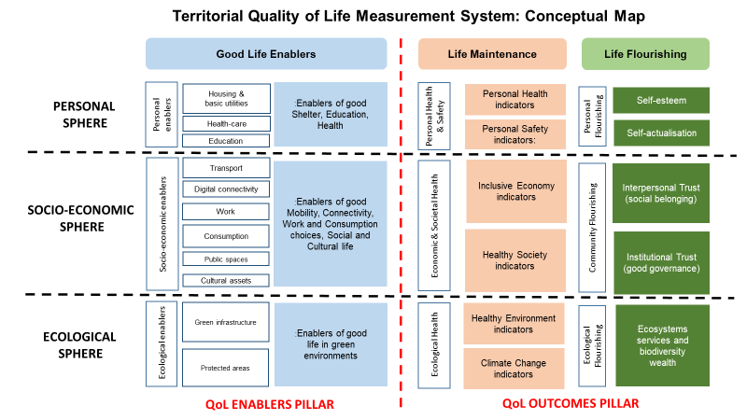
Territorial Quality of Life - conceptual map
Notes:
The conceptual map created by ESPON illustrates in further detail how the thematic spheres and conceptual dimension come together to provide a comprehensive framework for the definition of quality of life in terms of enablers and outcomes.
Thematic spheres of quality of life
personal sphere = personal health and safety needs and flourishing aspirations.
socio-economic sphere = economic well-being, and social and policy factors which support survival and flourishing of all people living in the place.
ecological sphere = quality of the environment and ecological flourishing as a key aspect of quality of life.
Conceptual dimensions of quality of life
Good life enablers = place-specific preconditions for each of the three thematic spheres.
Life maintenance = healthy personal life, healthy economy and healthy environment as outcome of a good quality of life.
Life flourishing = fulfilment of personal aspirations, community flourishing and ecological flourishing as outcome of a good quality of life.

Slide 7
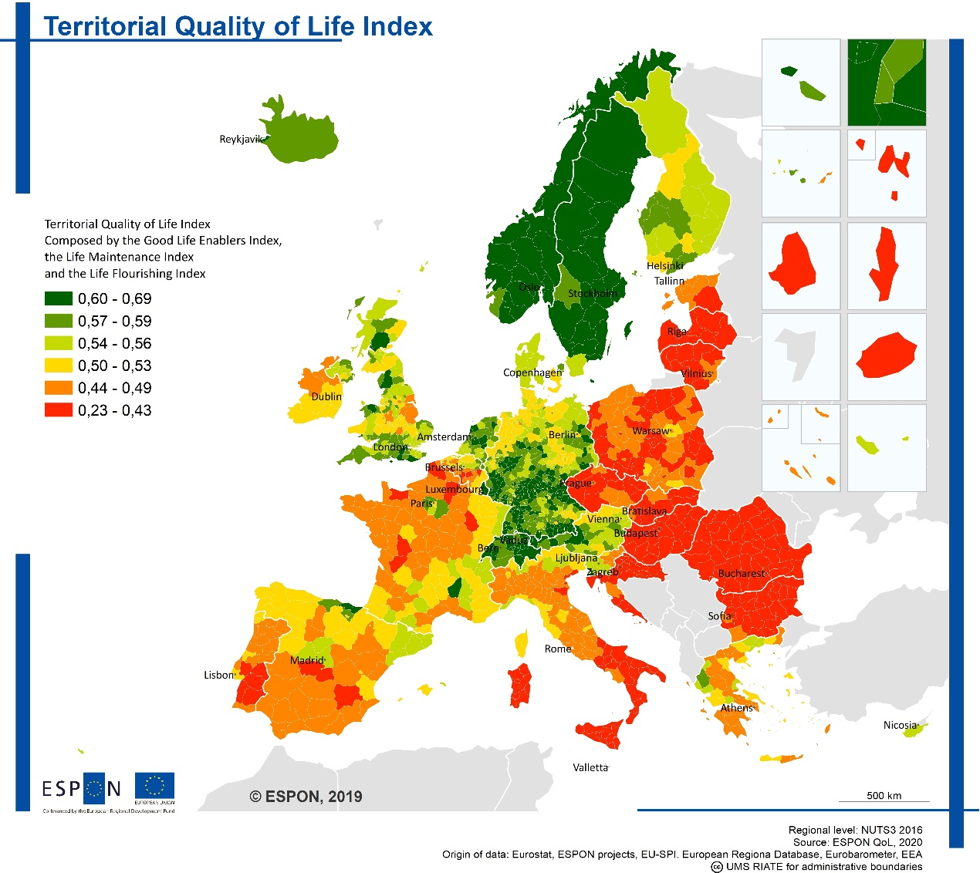
What is the state of territorial quality of life in Europe?
High QoL in the Nordic countries, in particular in Norway, Sweden, Iceland, Finland and Denmark.
Regions located in south-western Germany, Switzerland, western parts of Austria, the Netherlands perform well
High QoL has been identified in several regions in the Mediterranean: the Basque Country, Cantabria, Catalonia, Madrid and parts of Castilla León in Spain; eastern Macedonia and Epirus in Greece; Malta and Cyprus; Liguria, Friuli and Trentino in Italy; Slovenia; and the Rhone Valley, French Alps and Occitanie region in south-eastern France.

Slide 8
Overall, the results reflect, a centre-periphery pattern, mostly driven by the economic indicators related to health, education and the labour market
The maps should be interpreted with caution as European maps at regional level (NUTS 3 regions) are affected by the limited availability of statistical data, in particular environmental indicators and subjective indicators
Maps are very useful in highlighting the consequences of data gaps, and can contribute to stimulate data collection improvements and, to start discussions among various actors
What is the state of territorial quality of life in Europe?

Slide 9

How to measure the quality of life in practice?
IT
an advanced system for measuring the QoL is established
cross-border
region of Coastal–Karst Region (SI),
Istria (HR) and
Trieste (IT)
SI
a first attempt for measuring the QoL at the level of statistical regions is proposed and will be implemented within next years
HR
measuring of QoL in a structured way is not established yet
Notes:
The Slovenian EU Presidency in cooperation with ESPON engaged in the further development and deepening of the approach to place-based and citizen-centric quality of life assessments and applied it to the tri-national functional cross-border region of Coastal–Karst Statistical Region in Slovenia, County of Istria in Croatia and Trieste in Italy.
Highly integrated cross-border region with historical ties and intense commuting flows related to labour market, tourism, and education and other services (e.g. shopping, health services).
The measurement of the QoL at the level of cross-border area is not established yet. There are differences in this respect between the countries. In Italy, advanced system for measuring the QoL has been already established, in Slovenia the first attempt for measurement the QoL at the level of statistical regions is proposed and will be implemented within next years, while in Croatia, the measurement of QoL in a structured way is not established yet.
The integration of the quality of life in this cross-border area is mainly achieved through regional development plans and cross-border cooperation programs. Even if the projects under interregional and transnational cooperation programmes do not address quality of life directly, they significantly contribute to raising the quality of life in the cross-border area.

Slide 10
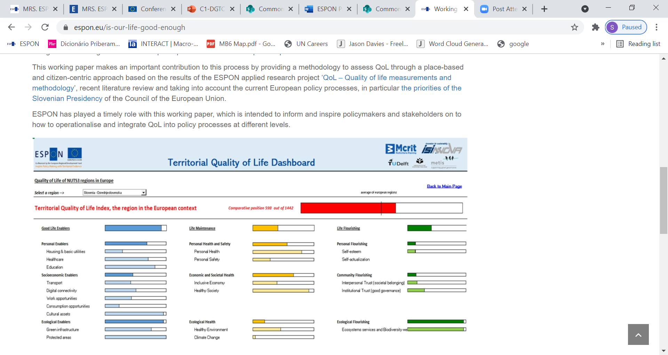
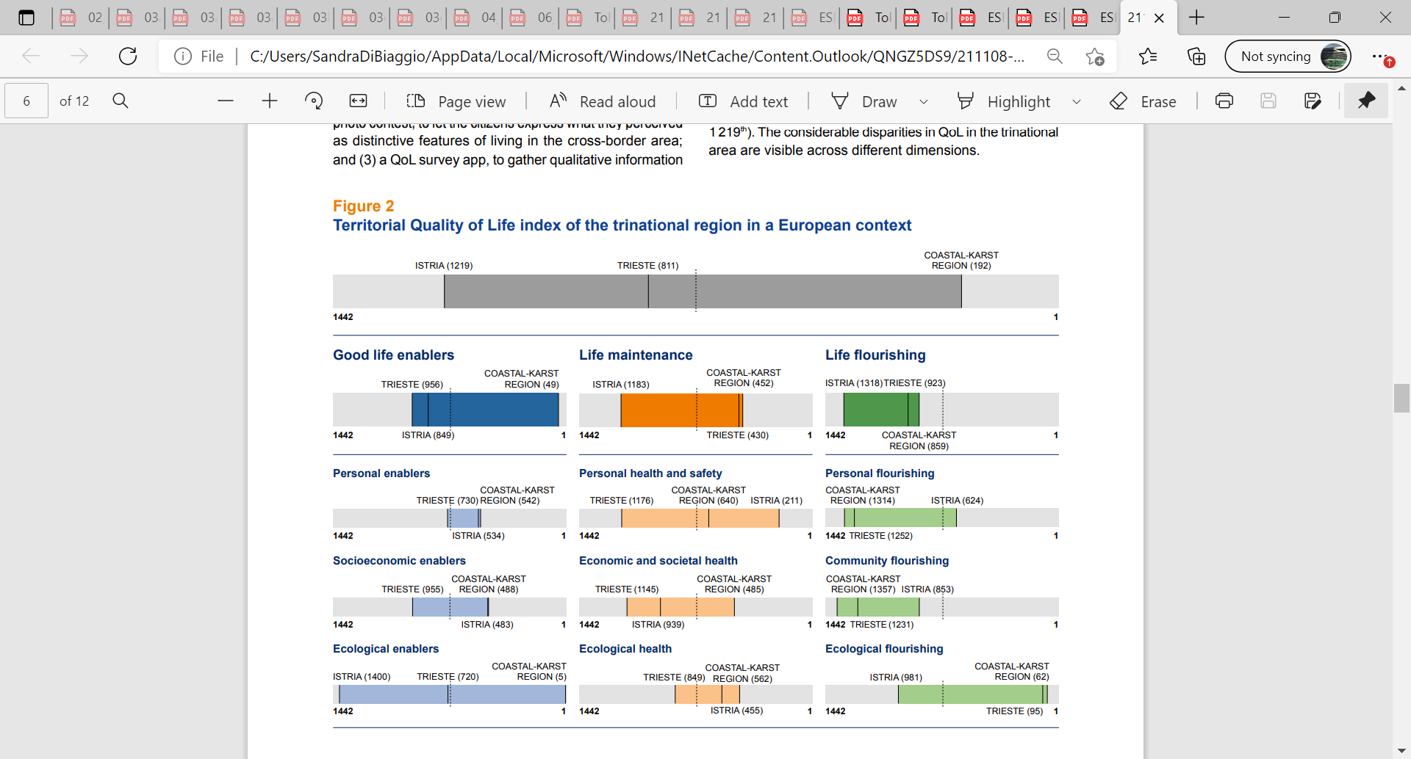
Territorial Quality of Life // Dashboard
Notes:
Territorial Quality of Life Dashboard :
is a application (in Excel), illustrating the methodology developed to measure quality of life;
covers the ESPON space (the EU, Iceland, Liechtenstein, Norway, Switzerland and the United Kingdom) and Western Balkans (Albania, Montenegro, North Macedonia and Serbia);
uses statistical indicators and weighting criteria to compute composite indices
is practical in comparing quality of life indicators at different territorial scales – European, national, regional and local – depending on the availability of relevant data;
can be applied to measure and monitor trends in quality of life over time in a given region, city, or rural or urban area.
The bars show the spectrum considering all regions covered in the ESPON ‘Territorial Quality of Life Dashboard’, the coloured sections show the spectrum of the tri-national region Costal-Karst-Istria-Trieste. Blue shows the combined index for ‘good life enablers’, yellow for ‘life maintenance’ and green for ‘life flourishing’. The further to the right a place is in the bars, the better is its ranking in a European comparison.

Slide 11
How to measure quality of life in practice?
Process, analyse and discuss
results
Collect people’s
experiences and
perceptions
Engage with citizens
Living lab focus groups
Digital photo contest
Qualitative survey app
Small groups discussions
Collect photos, indicating distinctive features of living in the cross-border area
Identify the best and worst aspects of living in the area and explaining why
Weigh the indicators in the dashboard tool, produce composite indexes that better reflect the QoL priorities of the people
Guide the policy making process
Notes:
The most crucial in this work was the citizens engagement involving three main elements:
Living lab focus groups,
digital contest and
quality of life survey app.
These are different ways for collecting quality of life experiences and perceptions of the people:
by asking them directly their opinion in small groups discussions,
to express their life experiences by submitting meaningful photos in a digital contest, representing what they perceive as distinctive features of living in the cross-border area
answering to questions administered through a qualitative survey app, telling what they think are the best and worst aspects of living in the area and explaining why (with concise statements).
The results of these innovative activities can be used to guide policies and weight the indicators in the dashboard tool, producing composite indexes that better reflect the quality of life priorities of the people.

Slide 12

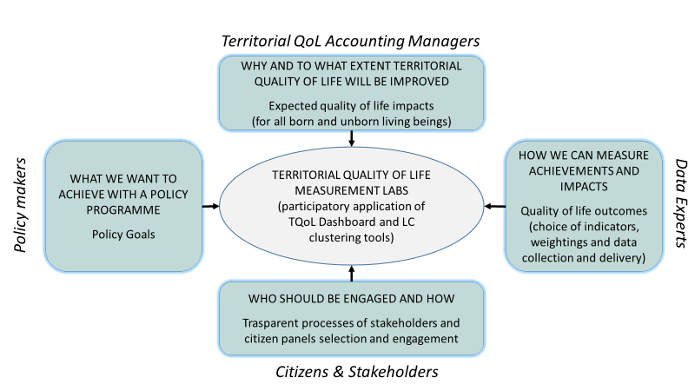

How can citizens be involved in this process?
TQoL Living Lab: knowledge of experts and decision-makers with the wisdom of citizens by means of co-creation and dialogue
A TQoL measurement lab is a policy innovation milieu where experts from various institutions work together with citizens and stakeholders to define QoL priorities, test indicators, and monitor and evaluate QoL
Notes:
Territorial Quality of Life Living Labs can be useful tools for better policy making for integrating quality of life in spatial planning policies and instruments.
They facilitate participatory approaches, putting the perception of people in the foreground.
Consequently, they help bring policies closer to people by grasping their needs, address their problems and create long-term impacts through strong partnerships

Slide 13
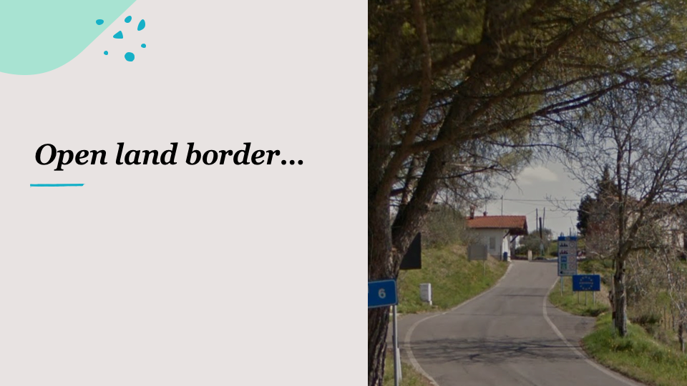

// examples of the photo contest
Notes:
Innovative actions for collection of subjective data, such as focus groups, qualitative surveys or digital photo contests can be used to collect qualitative data.
Quality of life is more about perception of people than only statistical indicators.

Slide 14
Key messages
QoL is a complex concept that helps public policies be more territorially-tailored by better understanding people’s perception of their own living conditions and by looking beyond economic output and living standards. It is an overarching objective of public policies.
It helps bring policies closer to citizens being it European, transnational, national or regional by making public participation integrated in spatial planning processes.
ESPON has developed an innovative approach to a place-based and citizen-centric understanding and measurement of QoL. It offers a unique opportunity to move policies beyond gross domestic product, implement a deliberative process empowering people as actors of change.
Key elements of the ESPON approach are a QoL conceptual map, a Territorial Quality of Life Dashboard and Territorial quality of life (TQoL) Living Labs
TQoL Living Labs can be useful tools for policymaking and, in particular, for integrating QoL in spatial planning policies and instruments. They facilitate participatory approaches, putting the perceptions of people in the foreground. Consequently, they help to bring policies closer to people by grasping their needs, address their problems and create long-term impacts through strong partnerships.

Slide 15


ESPON workshop “Is our life good enough?” at the 2021 European week of regions and cities
Public participation is part of spatial planning processes. The ESPON Quality of Life approach can help to improve it and to collect insights on people’s expectations, values.
Co-creation is essential. We need to re-think policy making, as top-down approaches don’t work anymore.
Blanka Bartol, Slovenia
Norry Schneider, Luxembourg
Collaborate with the local level, especially involving young people, matters - because today’s policies and changes shape our quality of life in 5 to 10 years.
Quality of life indicators can be used to better understand territorial inequalities and expected policy effects, which are important inputs to citizen-centric partnerships for development.
Marc Pfister, Switzerland
Rudina Toto, Albania

Slide 16
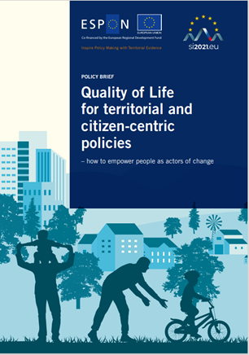
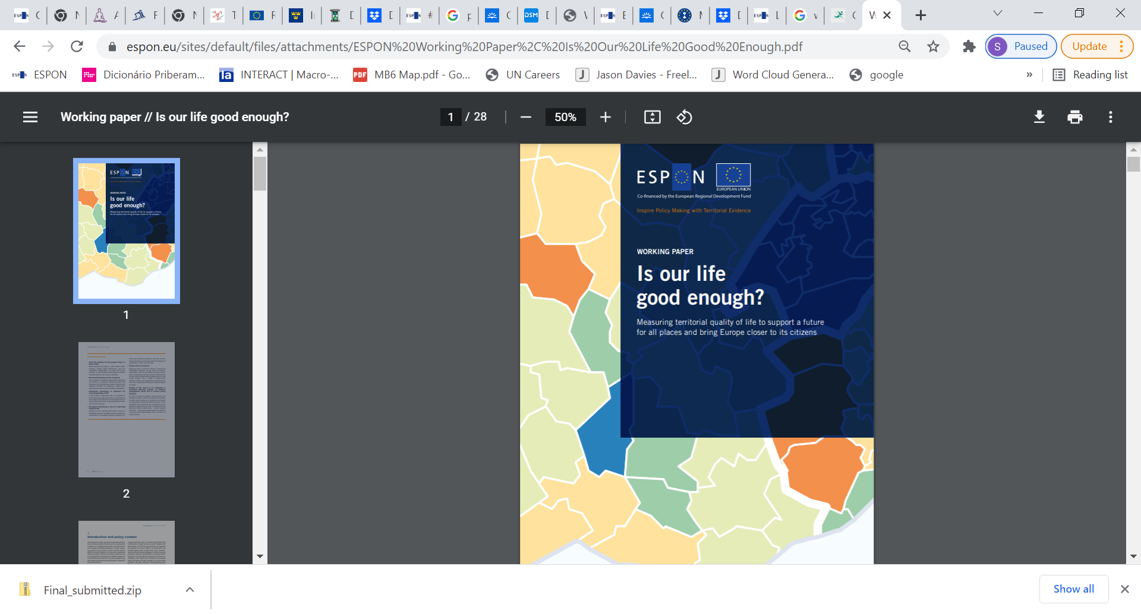
Quality of Life // ESPON Publications
https://www.espon.eu/programme/projects/espon-2020/applied-research/quality-of-life

Slide 17
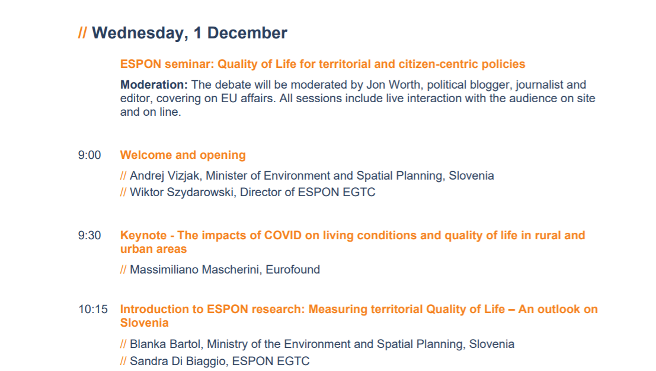
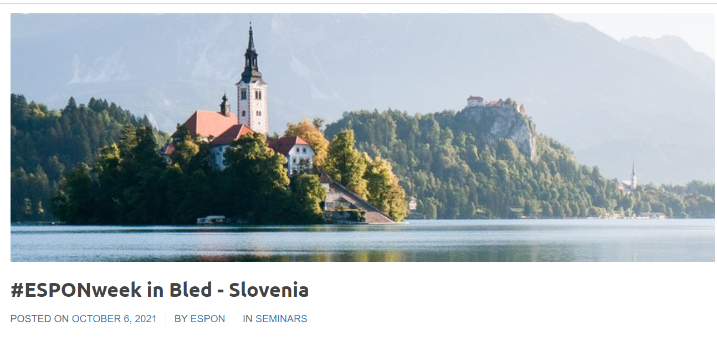
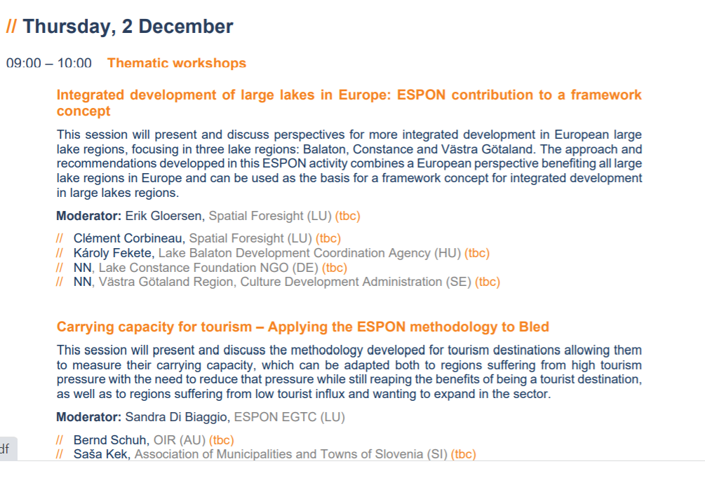
ESPON Seminar 1-2 December, Bled - Slovenia
Quality of Life for territorial and citizen-centric policies

Slide 18
Thank you
// sandra.di.biaggio@espon.eu
Senior Project Expert – Policy Analysis and Project Development
https://www.espon.eu

