Slide 1
Quality of Life in Urban Areas ESPON ACPA Adapting European Cities to Population Ageing
Luxembourg, 10 November 2021

Slide 2
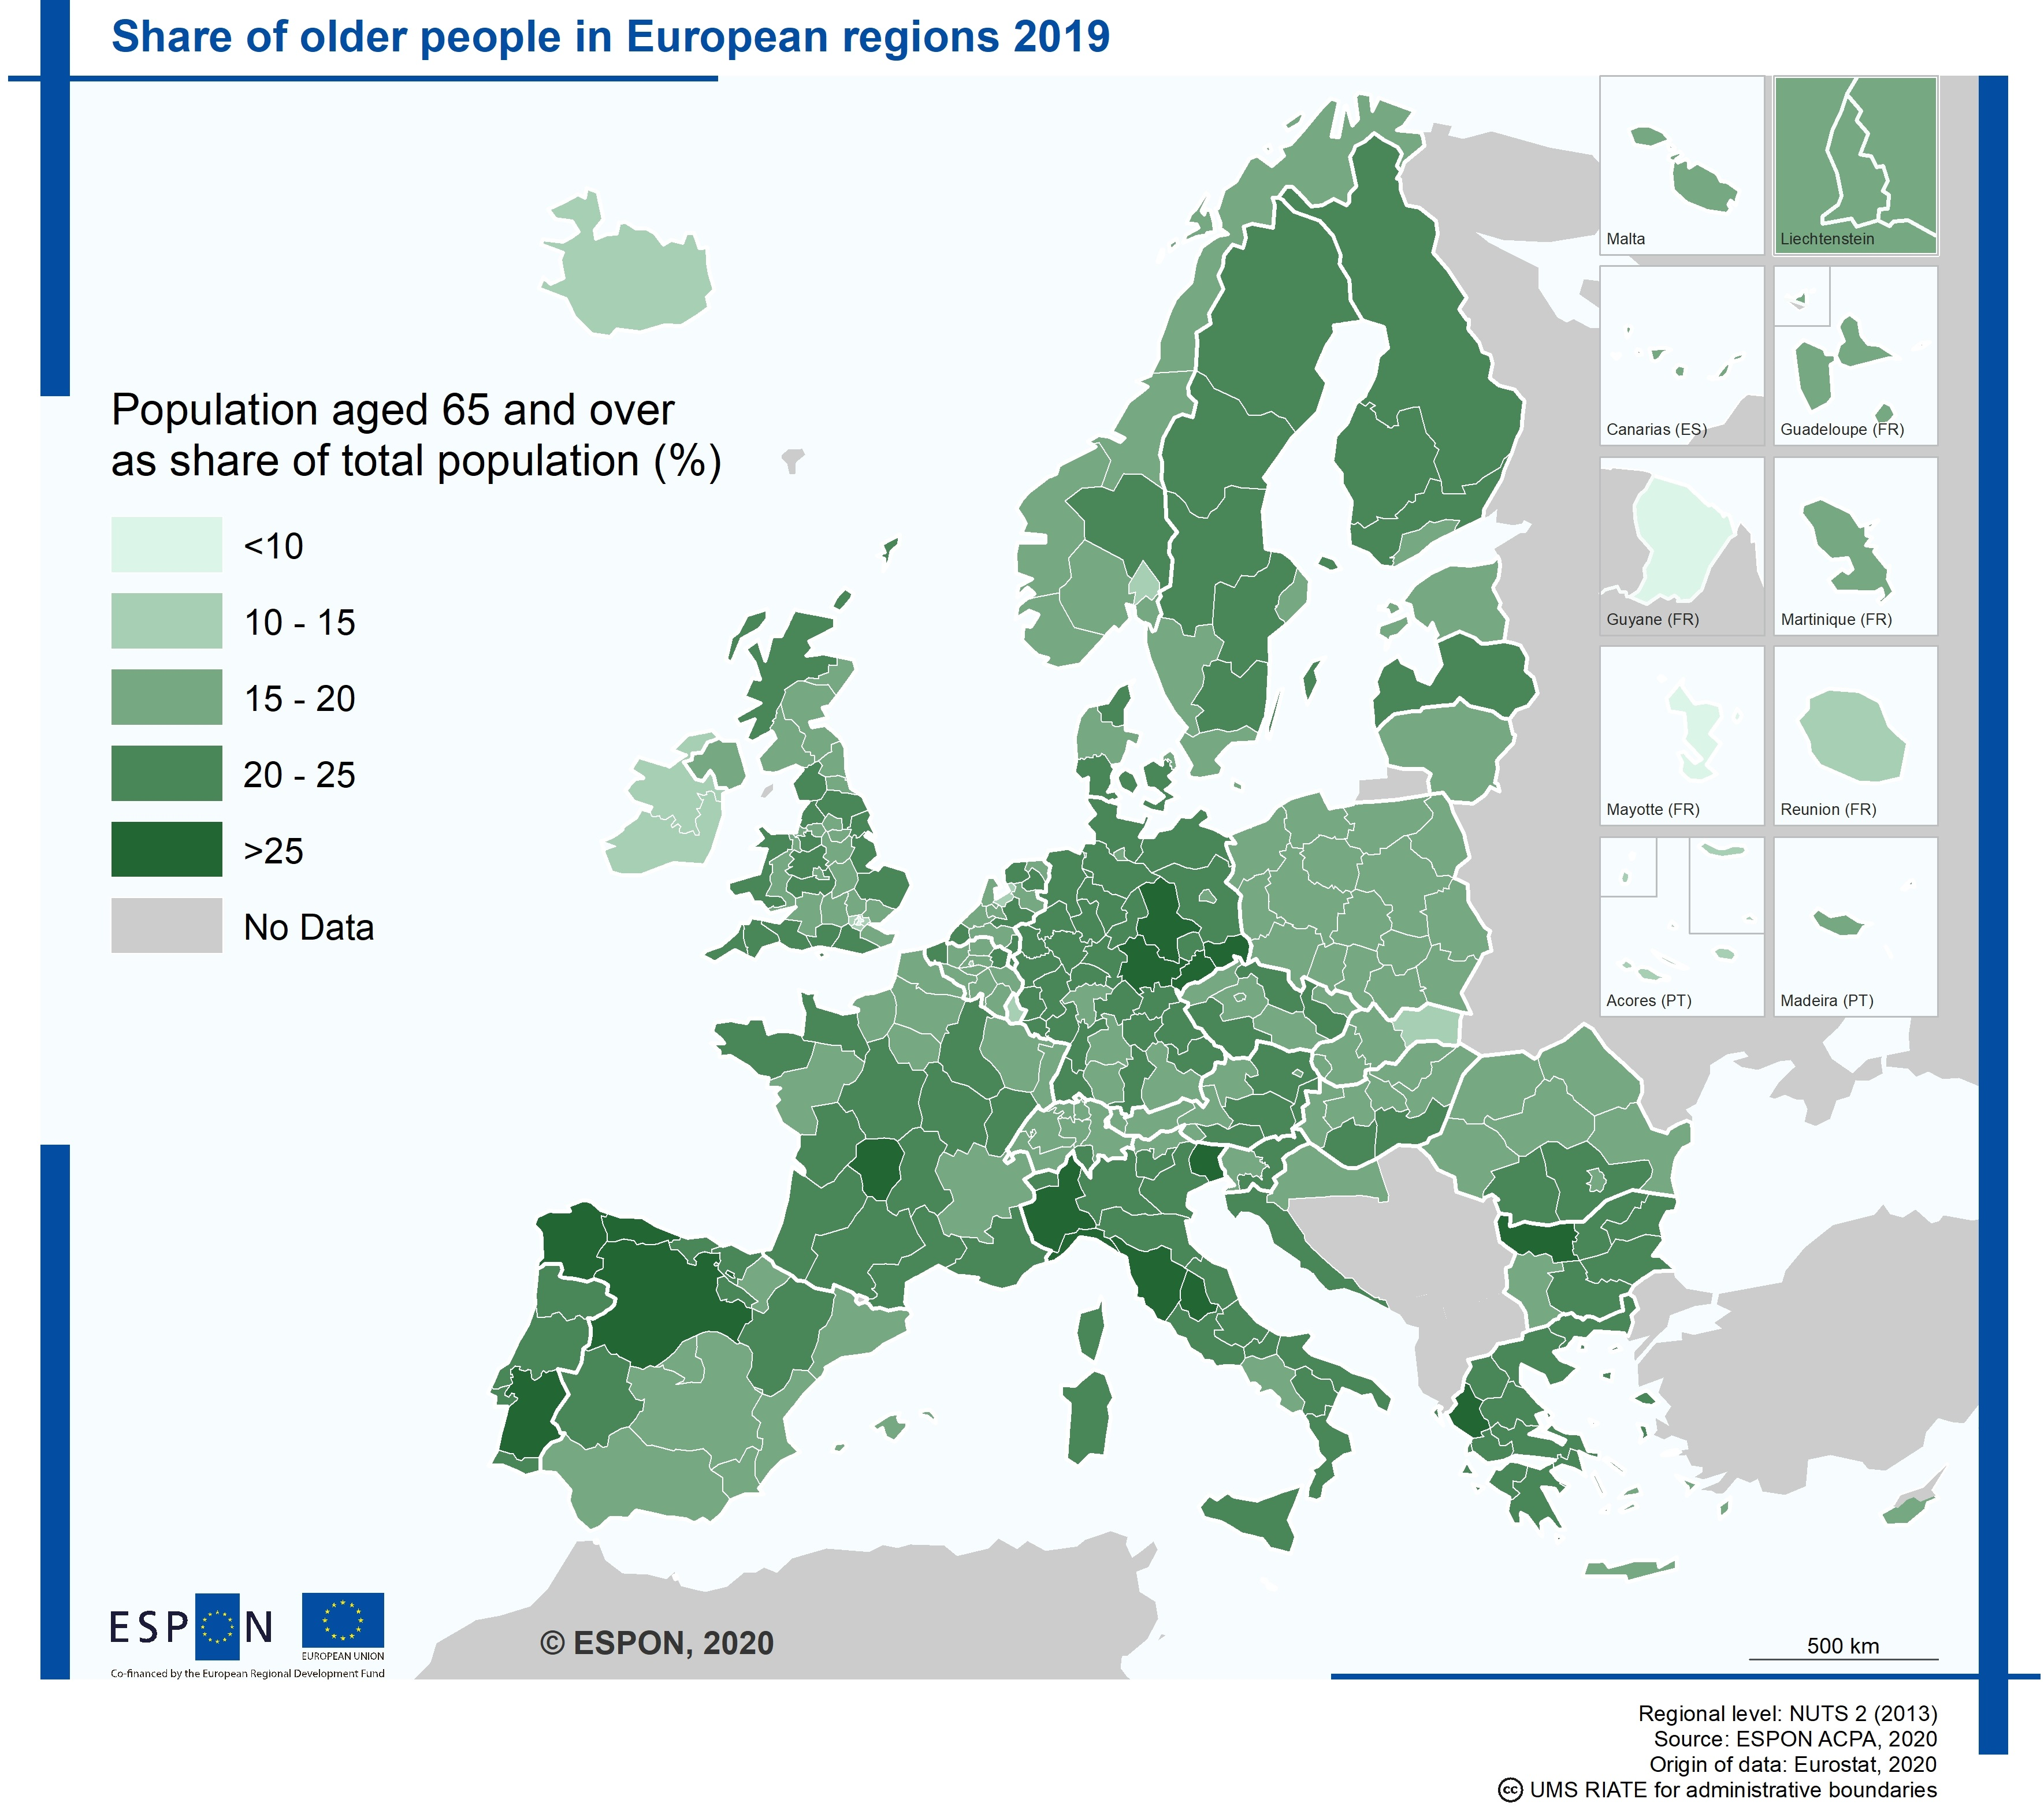
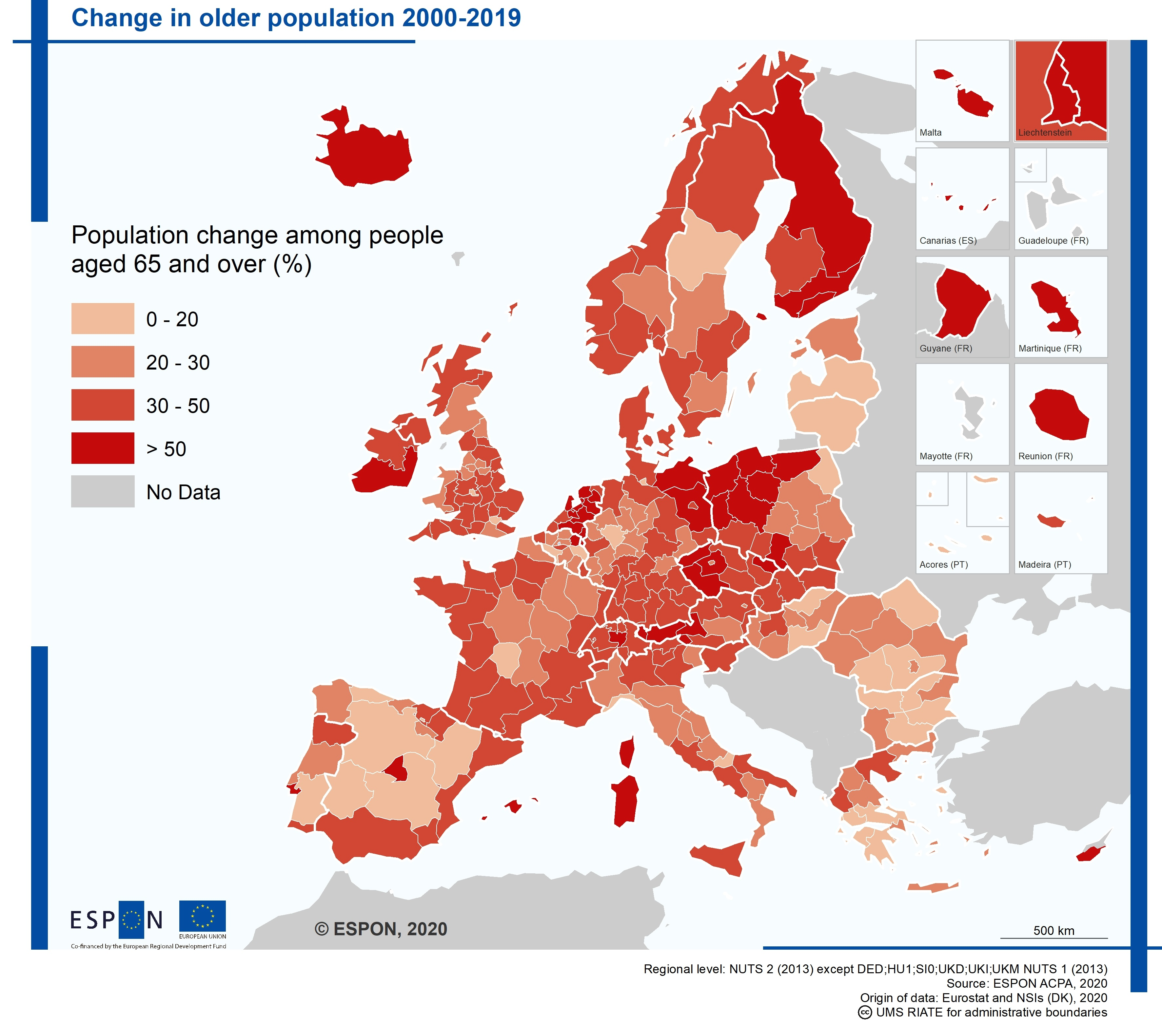
Europe’s population is ageing

Slide 3
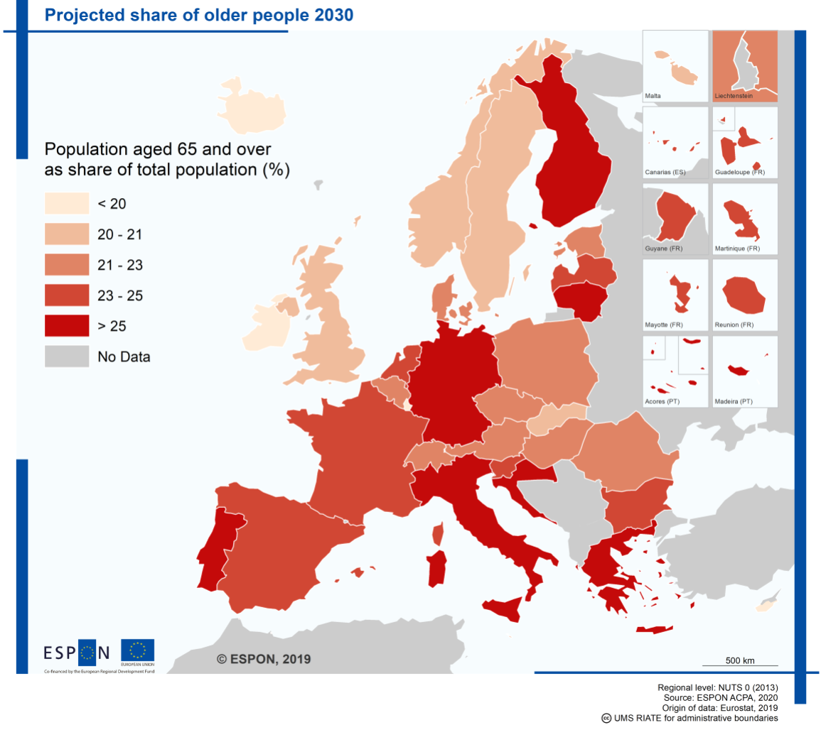
Europe’s population is ageing
…. and in 2050:
More than two-thirds of the EU Member States are projected to have an old-age dependency ratio above 50%
‘Super ageing’: number of people aged 85 years or more is projected to increase from 12.5 million in 2019 to 26.8 million by 2050

Slide 4
What affects the quality of life of older people in cities?
1

Slide 5
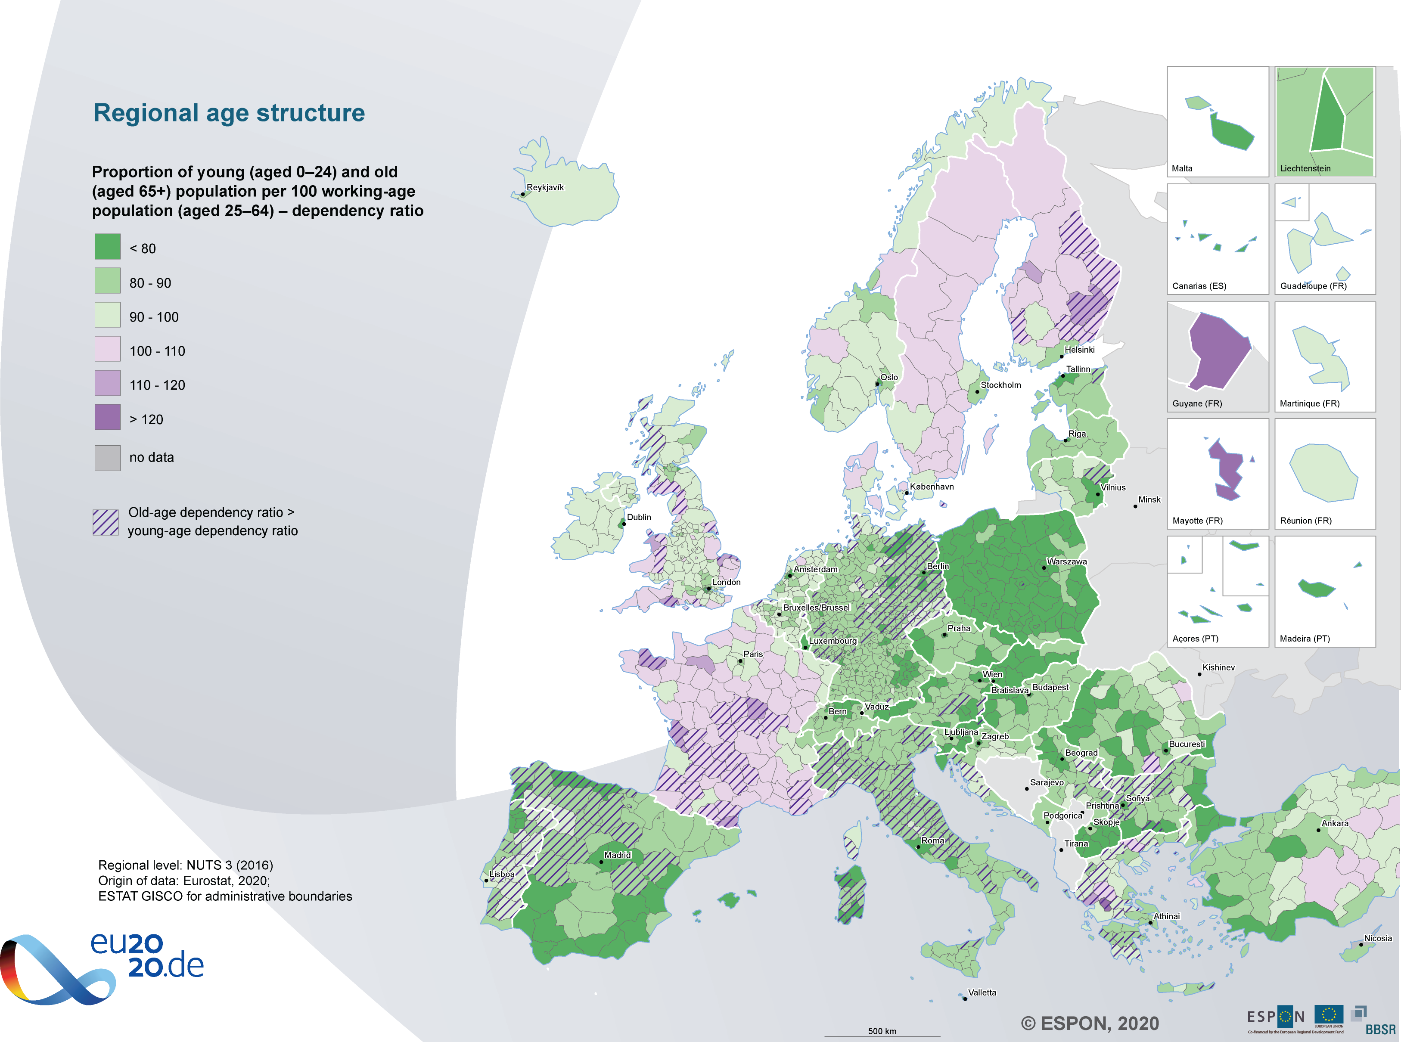
Challenges related to ageing
Urban regions in Europe need to become more aware of the challenges caused by population ageing. These challenges concern especially the labour market, housing, public service provision and social inclusion.
population ageing will require more public funding
old-age dependency is increasing: higher than young-age dependency in Germany, Greece, northern Spain, central and southern France, Italy, Portugal, Romania and eastern Finland.

Slide 6
What is an age-friendly city? Which policies have been the most effective in developing age-friendly cities and how have they been implemented?
2

Slide 7
WHO Age-friendly Cities framework
The WHO Age-friendly Cities framework proposes eight interconnected domains
WHO domains can help to identify and address barriers to the well-being and participation of older people.
The eight case study cities in ESPON ACPA (Manchester, Amsterdam, Barcelona, Gothenburg, Hengelo, Nantes, Oslo, Zaragoza) have mostly taken the WHO domains as inspiration for their own developed strategy.

Slide 8
Good practices per policy domain
ESPON ACPA: success factors for age-friendly territories
Policy domain |  | Good practice | Example (city)
 | 1. Outdoor spaces and buildings | Taking away barriers to visit outdoor spaces and buildings. Such barriers can have a physical and a social/cognitive dimension. | Age-friendly shopping (Zaragoza)
 | 2. Transportation | Tailored solutions that can bring older people to destinations where public transport is unavailable. Such solutions usually include personal assistance. | Rosa busser (Oslo)
 | 3. Housing | Optimal use of scarce residential real estate and stimulating intergenerational contact by letting seniors and students live in one building. | Viure i Conviure (Barcelona)
 | 4. Social participation | Platform for discussion of ageing – including sensitive topics – by older people without problematising it. | UP! – a new perspective on ageing (Amsterdam)

Slide 9
Good practices per policy domain
Good practices per policy domain
Policy domain |  | Good practice | Example (city)
 | 5. Respect and social inclusion | Cultural activities adapted to cultural backgrounds of older people | AVEM groups (Hengelo)
 | 6. Civic participation and employment | Active involvement of older people in the design and implementation of policies and activities | Older people as co-researchers (Greater Mancester)
 | 7. Communication and information | Combining multiple demands in one project: learning seniors to use digital technology, letting share personal experiences and reflecting on quality of life as well as giving them a voice towards the city council. | Life filming (Gothenburg)
 | 8. Community support and health services | Don’t forget about the people around the seniors. Especially informal caregivers tend to experience burden to perform their tasks and should be relieved where possible. | Maison des aidants (Nantes)

Slide 10
How can other cities learn from this and adapt successful policies?
3

Slide 11
Main lessons learned
Ageing in cities differs from other geographical contexts
Age-friendly policies are often cross-sectoral and integrated
Successful age-friendly policies create synergies across policy domains
Active involvement of the beneficiaries during design and implementation makes the difference

Slide 12
Main lessons learned
Successful initiatives are usually based on close collaboration across different actors (institutional and non-institutional)
It proves crucial to have a solid overview of both societal developments (‘policymaker’s view’) and understanding of how older people perceive their lives (‘senior’s view’)
Peer learning between cities provides very effective channel for policy development
Political commitment and funding are essential for sustainable success
The digital transition can bring new opportunities but also increase social exclusion

Slide 13
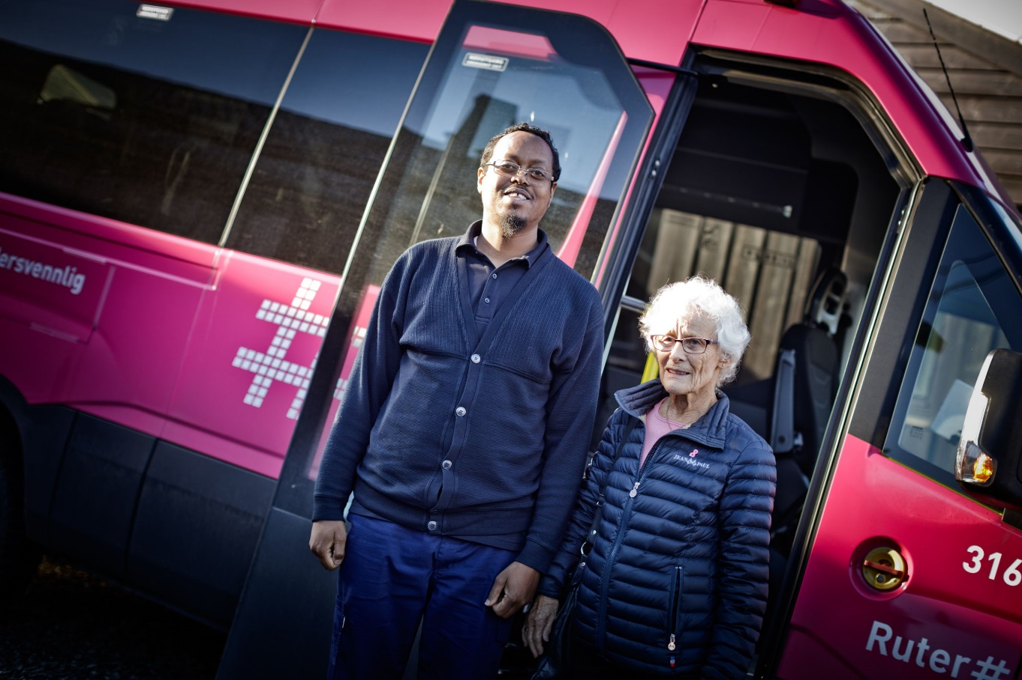
Case study examples
4

Slide 14
Success factors – Case study examples
UP! – A new perspective on ageing (Amsterdam)
Platform for discussion about sensitive topics, while maintaining an informal atmosphere
Style of communication: asking older people open questions, the use of everyday language, acknowledging that ageing is a dynamic process and no judging
UP! challenges older people to become active, but does not problematize ageing nor does it tell older people how to live their live

Slide 15
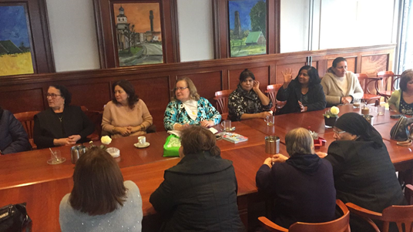
Success factors – Case study examples
Migrant older people groups (AVEM, Hengelo)
Meeting places for older people who speak Turkish, Suryoyo or Arabic. In the groups, participants and volunteers communicate in their mother tongue.
The participants develop and maintain social contacts and have the opportunity to ask questions or help one another with questions they have.
Integration between formal care and the meeting groups is valuable because the AVEM professionals have additional insights in the wellbeing of the individuals.

Slide 16
Success factors – Case study examples
Rosa busser (age-friendly transportation - Oslo)
Door-to-door service available to people over the age of 67, with a driver who is trained in assisting older people with cognitive or mobility challenges.
This age-friendly transport has also demonstrated that it is instrumental in ensuring that old people feel safe, active and independent.

Slide 17
Success factors – Case study examples
Viure i conviure (Living and sharing - Barcelona)
An older person hosts a student at home during the academic year.
This combats loneliness among older people and offers free housing for young students, while promoting solidarity.
It encourages them to stay in their homes while strengthening their social relationships. Its innovation also stems from the intergenerational aspect.

Slide 18
“Io Sto Bene”

Slide 19
Recommendations and key policy messages
5

Slide 20
Key Policy Messages
Ambition. Need for long-term strategy: a Silver Deal just like the Green Deal?
Flexibility and tailor-made approach. We are not all ageing the same way. A flexible approach is recommended in policy development related to ageing.
Positivity. Raising public awareness about ageing: positive approaches and language help to overcome negative stereotypes and secure the buy-in of older people for cities to become age-friendly.

Slide 21
Key Policy Messages
Outreach. From the local to the European level: user involvement is key to developing age-friendly cities and territories in line with people’s needs.
Learning. It is crucial to place more emphasis on monitoring and evaluation. Using wider expertise from academia, and a ‘test and learn’ approach, can drive innovation.

Slide 22
Recommendations for cities
Continuation of the Age-friendly City network concept
Age-friendly networks crucial for structuring age-friendly policies
Need to invest in a holistic and long-term strategy on active and inclusive ageing.
Long-term strategies with strategic and tactical goals are needed for stability
Development of leadership; radical change is required
Long-term goals should be translated into applicable 4- or 5-year goals, covering the city council’s term.
Development of an ecosystem for more collaboration
Consisting of institutional and non-institutional stakeholders. Municipalities with e.g. interest groups, civil society organisations, community workers, health organizations, leisure and sport facilities and restaurants
A networking organisation is necessary to facilitate this

Slide 23
Recommendations for cities
Collective approach towards all relevant European institutions
For example, awareness raising among members of European Parliament, together with AGE Europe
Raise public awareness about ageing.
This should turn negativism and stereotypes into a positive view on ageing.
Keep an eye on developments and demands, with attention to:
Digitalisation and similar threats to inclusion;
Diversifying populations and their needs;
Holistic approaches and multi-stakeholder involvement;
Consider the people around the senior.

Slide 24
Want to know more about ageing? Check out ACPA publications and Policy Brief!
Main report and synthesis report - EN
Policy handbook
EN / ES / FR / NL / NO / SE
Case study reports
EN / ES / FR / NL / NO / SE
https://www.espon.eu/ACPA
Policy Brief “The ageing revolution: towards a European Silver Deal?
https://www.espon.eu/ageing-revolution

Slide 25
// Thank you // Piera Petruzzi Senior Project Expert - European Outreach and Targeted Analyses

