Slide 1
LIFE Programme

Slide 2
The LIFE Programme
Budget: €5.4 billion

Slide 3
Types of grants funded under LIFE
Action Grants:
Standard action projects (SAPs)
Strategic Nature Projects (SNAPs)
Strategic Integrated Projects (SIPs)
Technical Assistance (TA)
Other Actions (OA) – including Coordination and Support Actions (CSAs)
Operating grants for NGOs

Slide 4
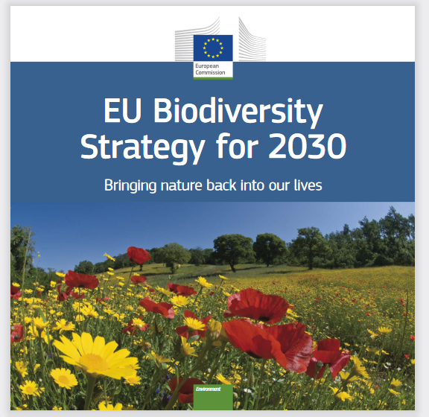
Nature and Biodiversity sub-programme
Aims at the protection and restoration of Europe’s nature and halting and reversing biodiversity loss
Supports project that contribute to the implementation of:
EU Birds and Habitats Directives, Natura 2000 network
IAS Regulation
EU’s Biodiversity Strategy for 2030
EU Green Deal
…
Budget: €2.143 billion

Slide 5
Standard Action Projects (SAPs)
‘Traditional’ LIFE projects
Co-financing rate of 60% maximum except:
67% for project targeting both priority and non-priority habitats and/or species
75% for projects targeting exclusively priority habitats and/or species
Maximum 10-year duration

Slide 6
Strategic Nature Projects (SNAPs)
Focused on
the implementation of the Prioritized Action Frameworks (PAFs) pursuant to the Habitats Directive or other plans or strategies adopted at international, national, regional or multiregional level by nature and biodiversity authorities
mainstreaming relevant nature and biodiversity objectives into other policies and funding programmes
Co-financing rate of 60% maximum
Maximum 14-year duration

Slide 7
LIFE projects in Luxembourg

Slide 8
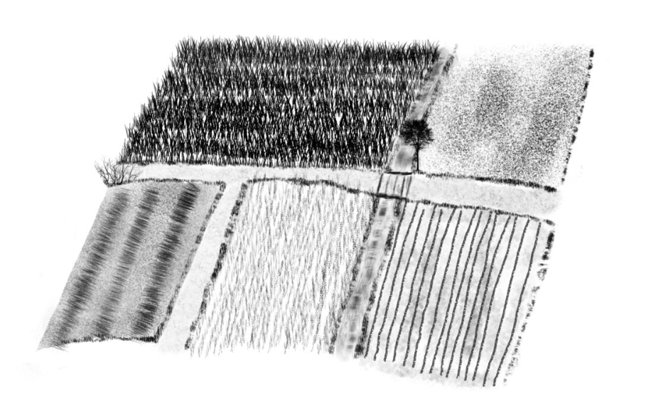
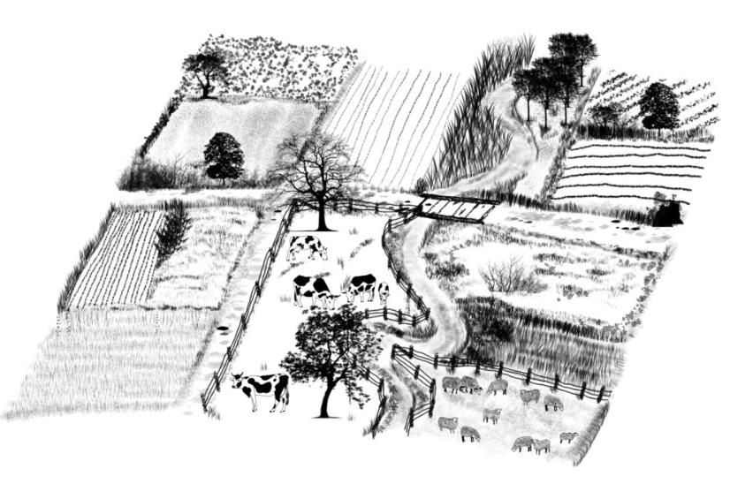
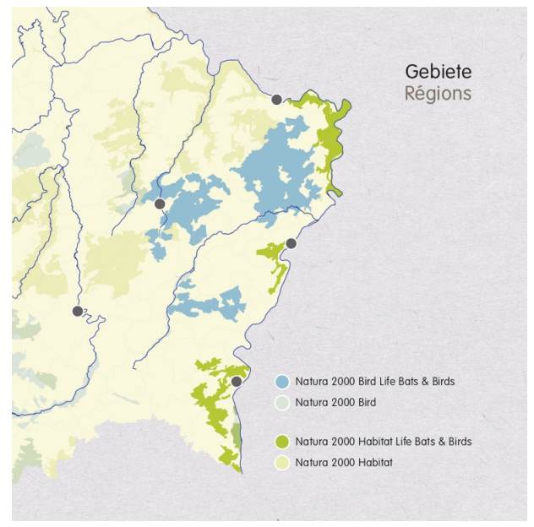
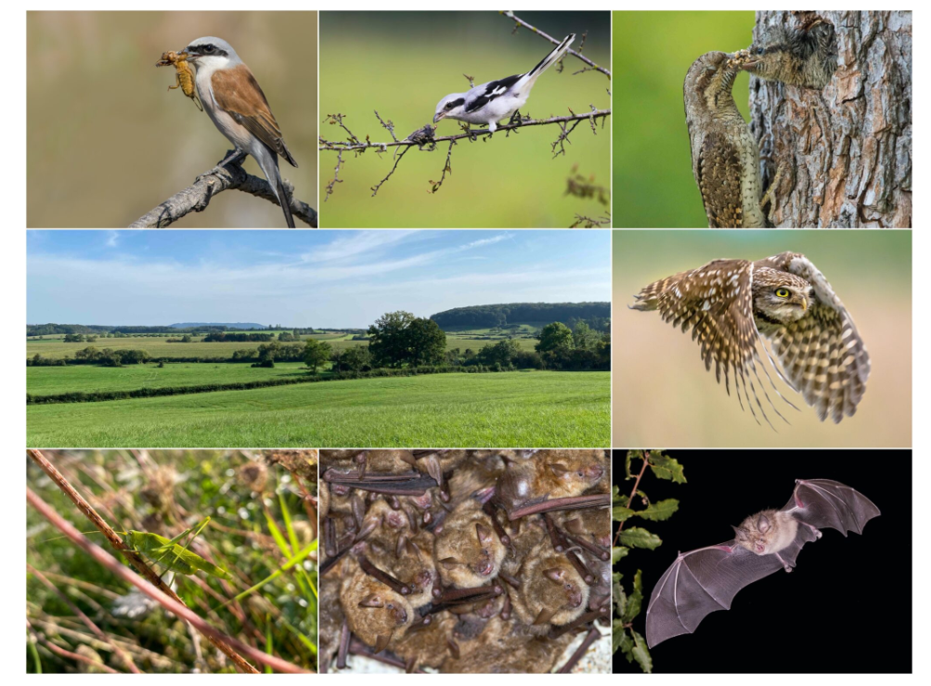
LIFE projects in Luxembourg
www.life-bats-birds.lu
Photo credits: Adobe Stock; natur&ëmwelt

Slide 9
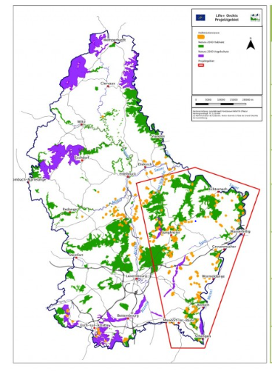
LIFE projects in Luxembourg
www.life-orchis.lu
Photo credits: natur&ëmwelt

Slide 10
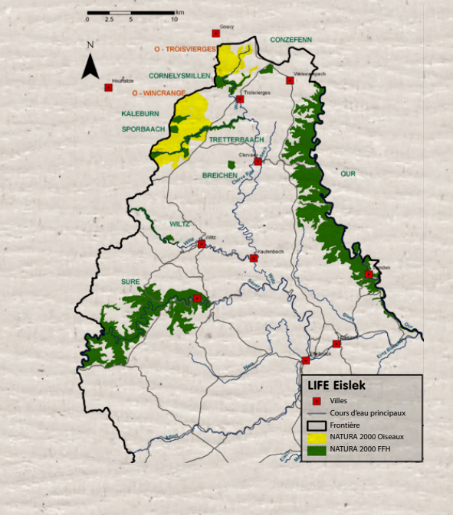
LIFE projects in Luxembourg
www.life-eislek.lu
Photo credits: natur&ëmwelt

Slide 11
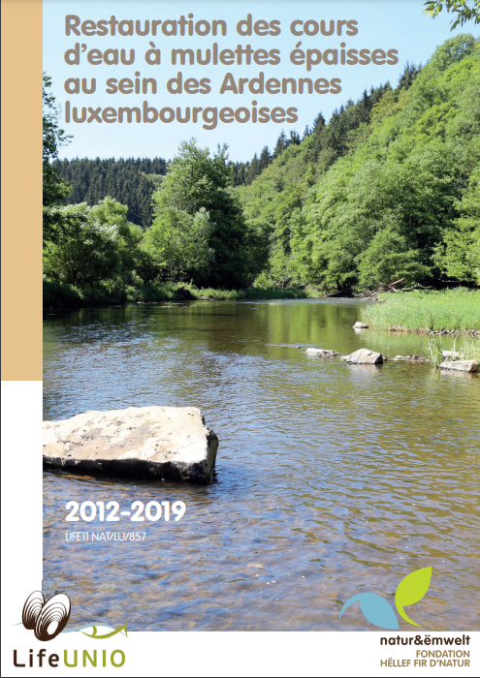
LIFE projects in Luxembourg
LIFE Alzette
LIFE Margaritifera
LIFE Unio
LIFE Batraciens
LIFE NATURA 2000-LUXEMBOURG
LIFE Grassland
www.life-unio.lu

Slide 12
More information on LIFE
LIFE website: https://cinea.ec.europa.eu/programmes/life_en
LIFE contact points in LU:
nora.elvinger@mev.etat.lu:
Nature & biodiversity
Climate change adaptation
jil.schmitz@mev.etat.lu:
Climate change mitigation and adaptation
Circular economy and quality of life
Clean Energy Transition
Call 2023 (for SAPs):
Launch approx. April/May 2023
Application deadline approx. October/November 2023
Thank you for your attention

