Slide 1
ESPON GRETA – “GReen infrastructure: Enhancing biodiversity and ecosysTem services for territoriAl development”
ECP Luxembourg annual conference “Territorial dimension of the protection of biodiversity and nature”, 8 November 2022
Michaela Gensheimer, ESPON EGTC

Slide 2
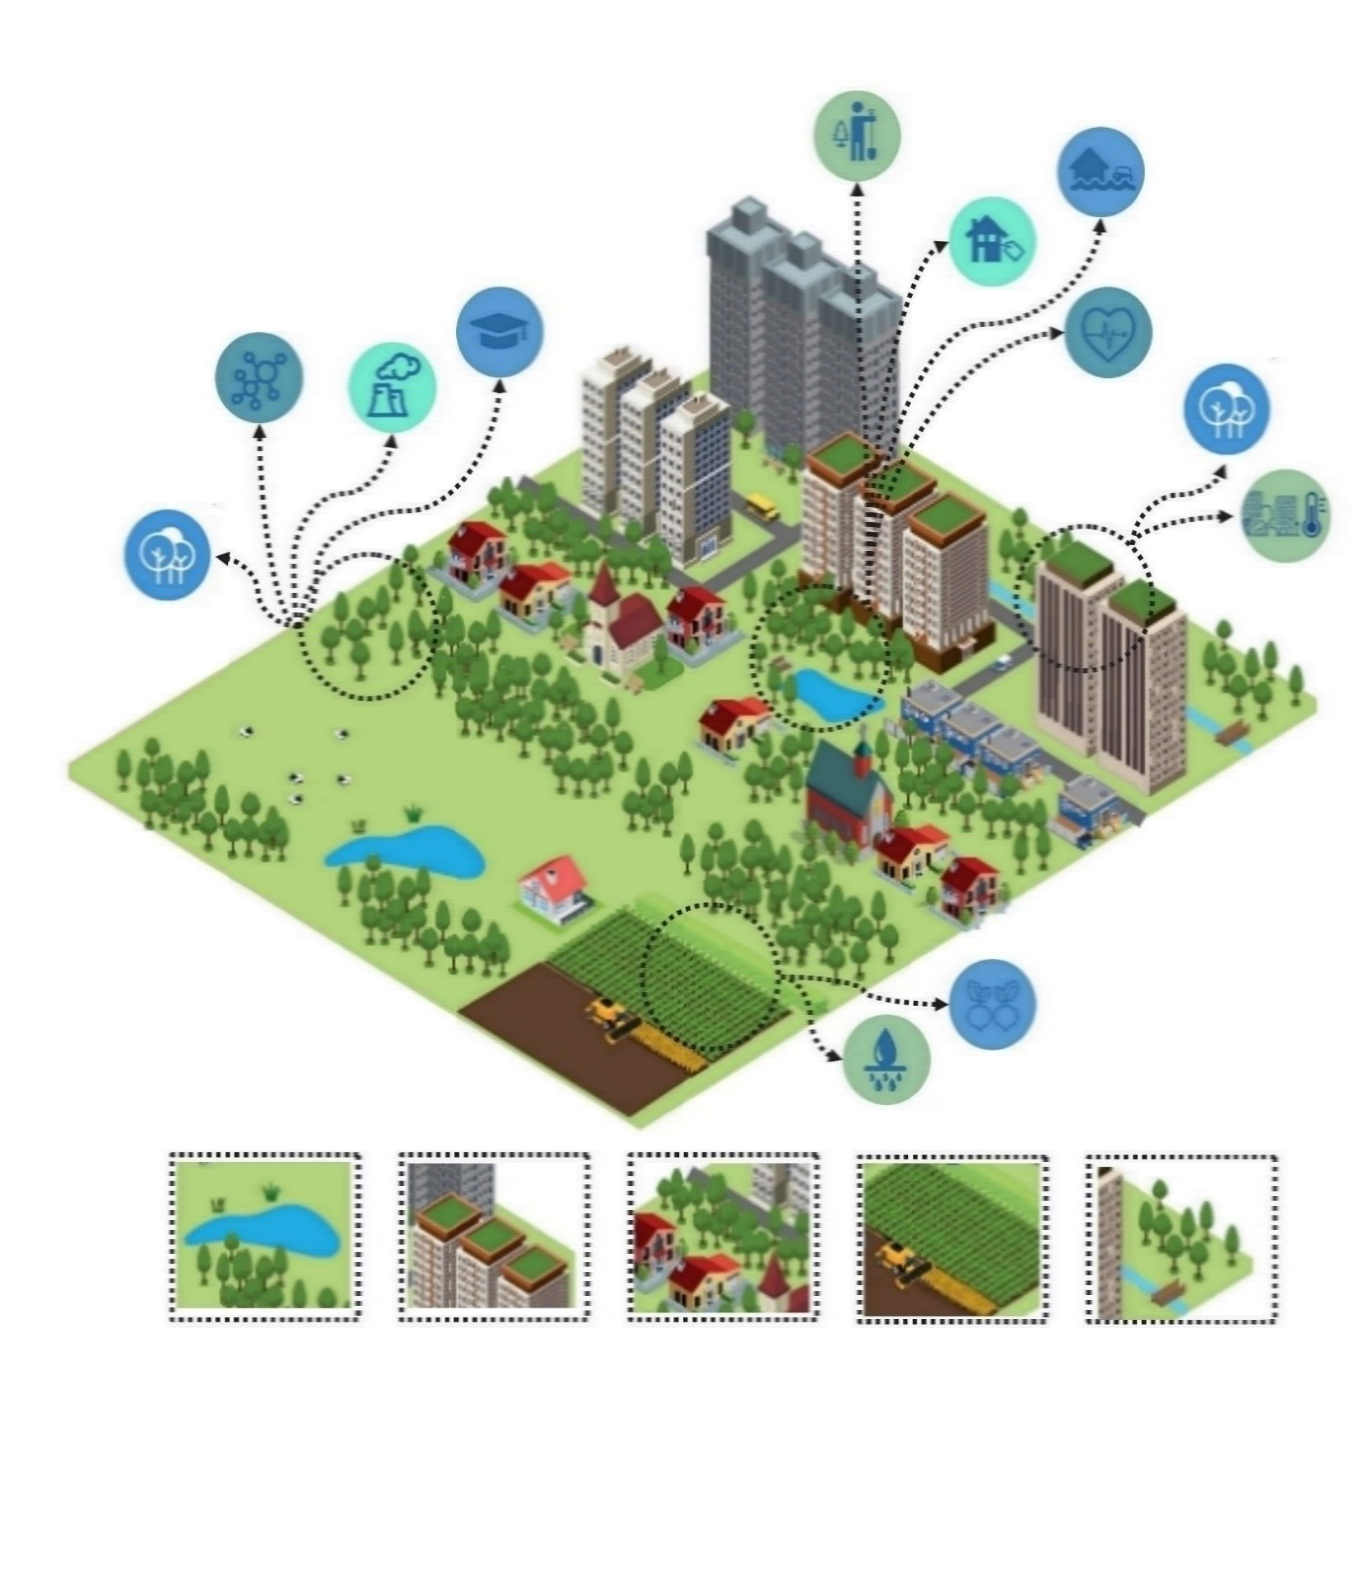
What can we learn from ESPON GRETA?
Purpose of ESPON GRETA
Territorial patterns of access to GI across European regions and cities
Potential effects of GI and ES on development of regions and cities
Further integration of GI in spatial planning and territorial development
Supporting factors for GI development and investment in ES
Wetland
Green roofs
Urban trees
Hedgerow bordering agricultural field
River and riparian vegetation

Slide 3
ESPON GRETA
Steps to assess the potential of GI to provide ES and how to manage GI to fulfil these needs
ESPON applied research project running from September 2017 – March 2019
Supported by national experts from SI, LV, CZ and European Commission (DG Research & Innovation)
Provides evidence on territorial patterns of GI and ES in different parts of Europe and different types of regions and cities (NUTS 2/3)
3 GRETA briefings providing concrete advice to everyone working with GI in practice
32 national policy factsheets describe policy and planning contexts for GI
12 case studies of different types of European regions and cities (supported by local/regional/ national stakeholders)

Slide 4
Guiding questions for GRETA
How do European regions and cities fare in offering access to GI and ES, and meeting the existing demand for regulating, provisioning and cultural services offered by GI and ecosystems?
What are the potential effects, both positive and negative ones, of GI and ES on the development of regions and cities?
How do European regions and cities look at the concept of GI and ES? What kind of knowledge do they need to anticipate and benefit from this opportunity?
To which degree is GI rewarding from an economic point of view, particularly in a long-term perspective? What could policy makers do to overcome the potential resistance of the private sector to GI investment?
How can GI be further integrated in spatial planning and territorial development?

Slide 5
Territorial pattern of access to GI across European regions and cities
Cities with higher accessibility are scattered throughout Europe, but tend to be dominant in SE, FI, Baltic countries, CZ, AT, DE and PT.
On the other hand, cities in IE, DK, UK are on the lower range of the accessibility scale.
Differences in accessible GI depend on several factors such as quantity of GI, its distribution (concentrated, patchy, dispersed, etc.), proximity to roads and trails, to name the most relevant ones.
=> Having GI does not ensure it is accessible.

Slide 6
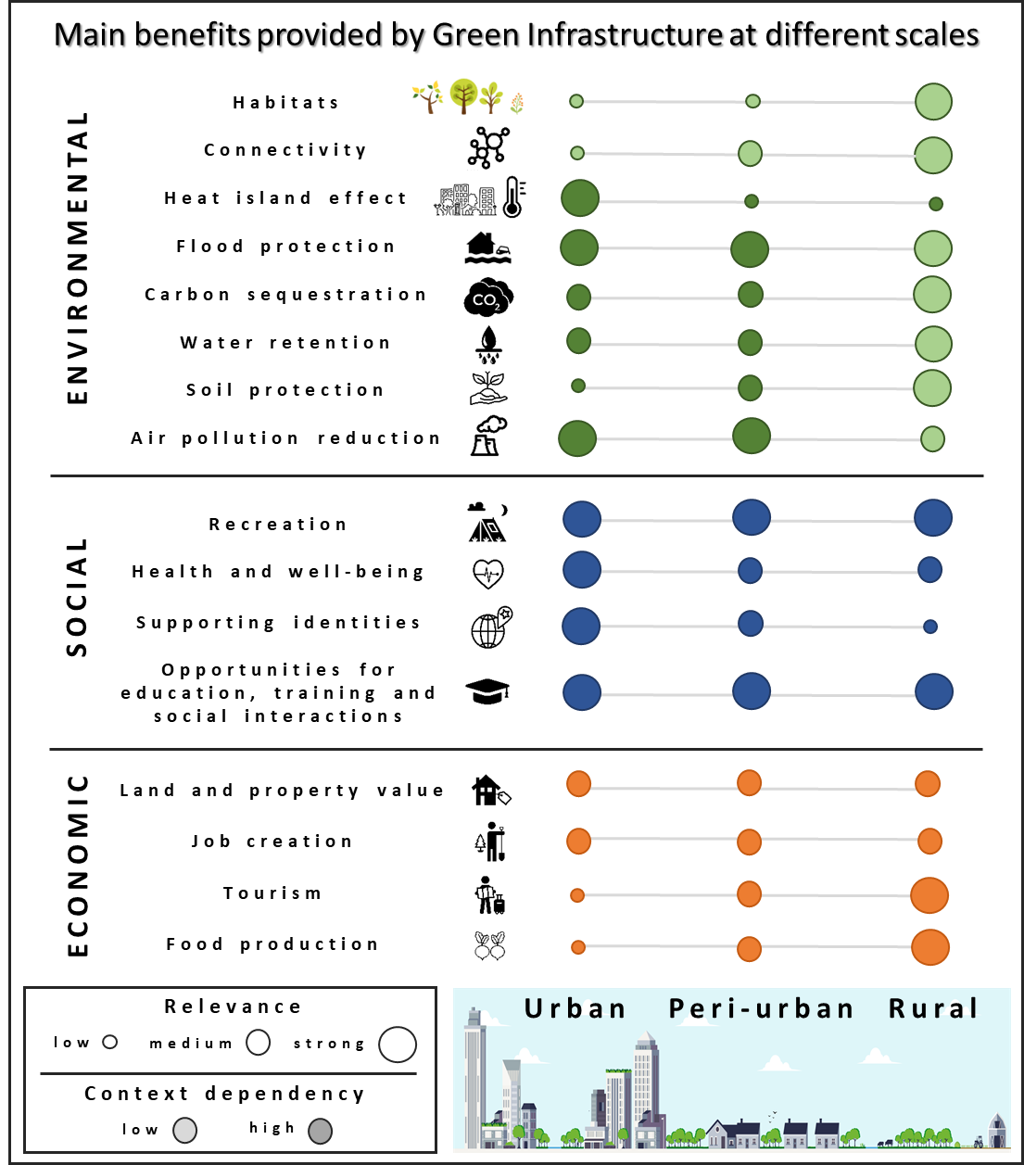
Potential effects of GI and ES on the development of regions and cities
The multifunctional character of GI provides a range of benefits by means of a variety of ES, which often appear in bundles and, under certain circumstances, are mutually reinforcing.
Potential side effects of GI that are important to be aware of:
Risk of invasion by alien species
Eco-gentrification
Human health effects
Higher costs to initiate or maintain GI

Slide 7
Further integration of GI in spatial planning and territorial development
GI approach to planning, i.e. looking for connections between different elements of nature, between nature and people’s quality of life, across ecological and political boundaries, and across policy sectors.
Strategic Environmental Assessment (SEA) can be a suitable policy tool for incorporating GI into strategies, plans and programmes.
Including GI in SEA could
help to establish a common framework for implementing GI in all EU member states,
contribute to enhance strategic thinking,
position ecological processes and their benefits as relevant planning criteria.

Slide 8
Further integration of GI in spatial planning and territorial development
Regional level:
Plan for GI implementation in adaptive cycles
Take synergies and trade-offs between ES into account
National level:
Integrate GI across policy areas
Develop national GI policies and action plans
Increase awareness bout GI
Ensure data availability
Provide training on economic valuation and spatial analysis methods
Local level:
Identify existing assets and opportunities for GI
Identify benefits and challenges of GI
Create a shared vision
Take the context into account
Identify GI “hotspots”
Combine private and public funding mechanisms for GI implementation
Monitor progress and adapt to change

Slide 9
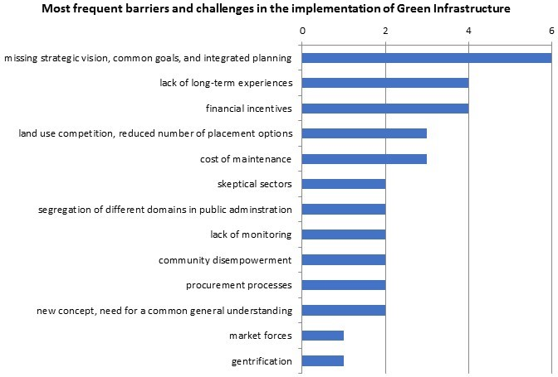
Supporting factors for GI development and investment in ES
Most important: a strategic vision for implementing GI
Knowledge of monetary value attached to and benefits derived from GI as opposed to grey solutions.
Long-term political commitment at all scales of governance.
Ideally a cooperative process combining bottom-up and top-down approaches.

Slide 10
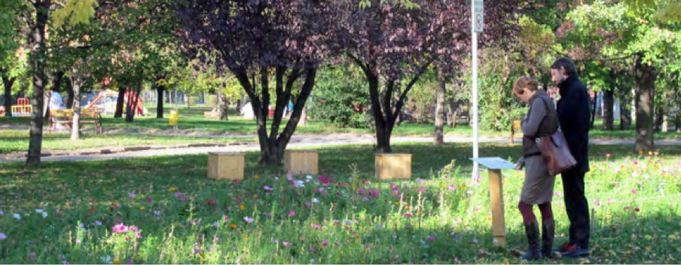
Supporting factors for GI development and investment in ES
Potential instruments for direct GI implementation/management by municipalities
Innovative use of public budgets, e.g. pooling funding from different departments or using previously untapped sources (e.g. public health budget).
Grant funding and donations, incl. EU funding, grants from regional and national public bodies, philanthropic contributions, crowdfunding.
Instruments generating revenue, such as revenues from land sales or leases; taxes; user fees; sale of development rights and leases.
‘Green finance’ (or debt-based instruments), e.g. loans from public or private financial institutions; green bonds.
‘Green areas inner-city agreement’, Bologna (IT)
Businesses calculate their carbon footprint and compensate it voluntarily by donations to municipality for tree planting.
City plants trees and maintains them for three years.

Slide 11
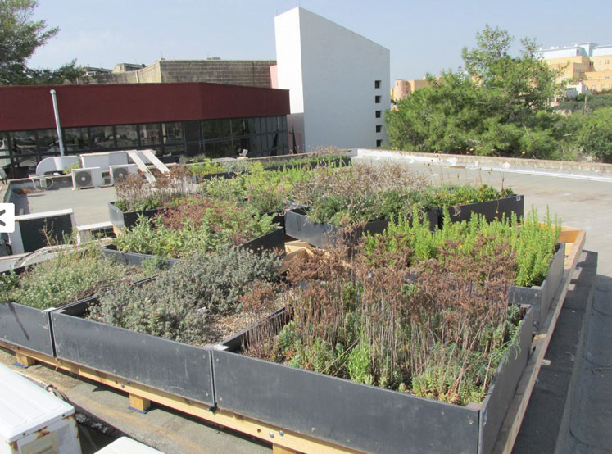
Supporting factors for GI development and investment in ES
‘Bratislava Turns Green’
Private households contribute to protecting the city from pluvial flooding, using subsidies from municipality to buy stormwater management systems.
Potential instruments for indirect GI implementation via encouragement of other actors
Market based instruments, e.g. user charges; tax rebates; credit-trading systems; payments for ecosystem services.
‘Business Improvement Districts’ to finance and deliver e.g. GI improvements to commercial/industrial environments.
Endowments, e.g. through donation of property or money. The interest accrued from the investment of the funds is used to pay for GI maintenance, leaving the original endowment untouched.
Public-Private Partnerships for delivery/maintenance of GI.
Community asset transfers, i.e. local authorities may transfer management or ownership of public land to community organisations.

Slide 12
Michaela Gensheimer Senior Project Expert, ESPON EGTC
More information: https://www.espon.eu/sites/default/files/attachments/GRETA_Sc_Annexes_Final_Report.pdf
(Annex IV-A, chapter 20 for Luxembourg factsheet)
www.espon.eu/green-infrastructure-urban-areas
www.espon.eu/working-paper-territorial-potentials-green-infrastructure

